Slide 1
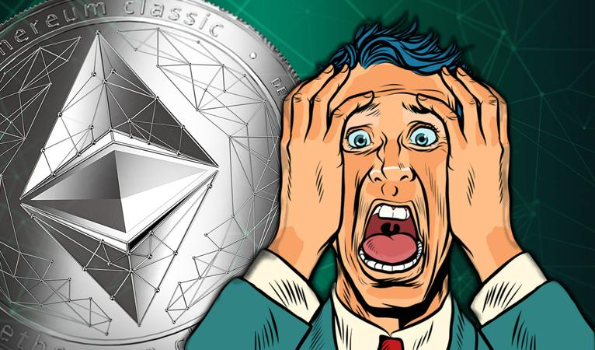
A Survey of Attacks on Ethereum Smart Contracts
Dhairya Bimal
Chandarana(1001948937)
Ritesh Murali(1001937460)

Slide 2

Table of Contents:
Goals
Blockchain context
Smart contract and its limitations
Taxonomy of vulnerabilities in smart contracts
Attacks in ethereum smart contracts
Verification of smart contracts
[6]
[1]

Slide 3

Goals
[2]
Investigating issues in Ethereum
Examine security flaws of Ethereum Smart Contracts
Demonstrating series of attacks that can take advantage of these flaws.

Slide 4
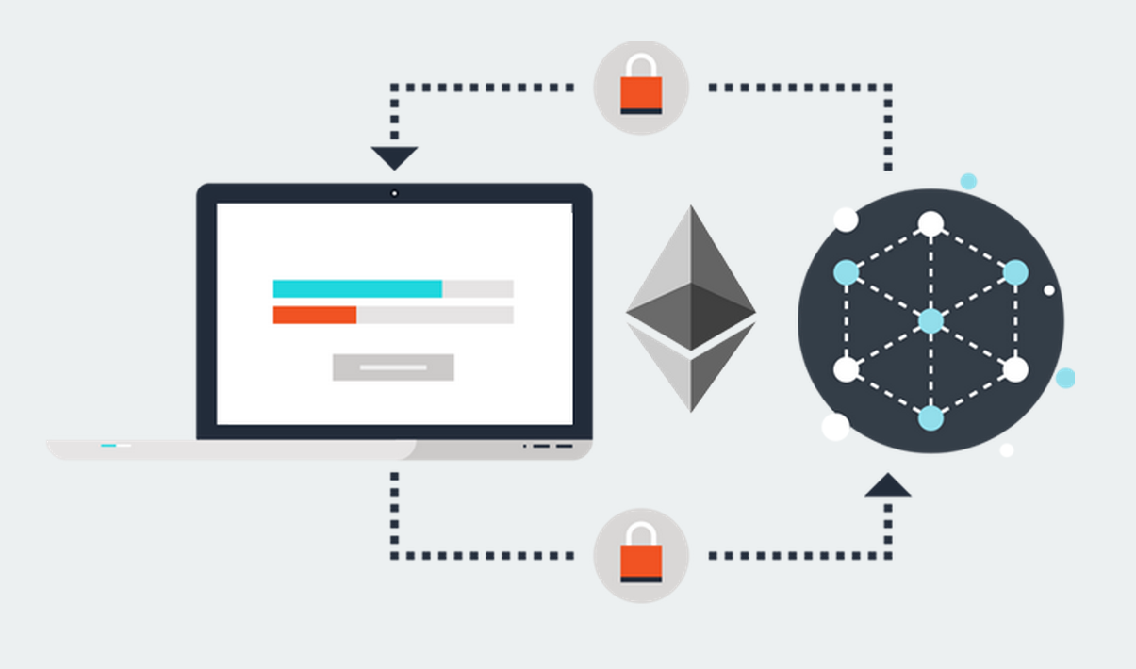
Blockchain & Ethereum Smart Contracts
Blockchain is a Append Only Data Structure
A blockchain is a public database that is updated and shared across many computers in a network.
They must spend ether to have their transaction recognized on the blockchain in order to make a transaction. These fees are referred to as gas fees.
A "smart contract" is simply a program that runs on the Ethereum blockchain.
[5]

Slide 5

Vulnerabilities in Smart Contracts
Level | Cause of Vulnerability
Solidity | Call to Unknown
 | Type Casts
 | Reentrancy
 | Keeping Secrets
EVM | Immutable Bugs
 | Ether lost in transfer
 | Stack size limit
Blockchain | Unpredictable State
[7]

Slide 6
Call to Unknown/Type Casts
contract Alice { function ping(uint) returns (uint) }
contract Bob { function pong(Alice c){ c.ping(42); } }
The first line declares the interface of Alice’s contract, and the last line contain Bob’s contract: therein, pong invokes Alice’s ping via a direct call. Now, if the programmer mistypes the interface of contract Alice (e.g., by declaring the type of the parameter as int, instead of uint), and Alice has no function with that signature, then the call to ping actually results in a call to Alice’s fallback function.
if c is not a contract address, the call returns without executing any code
if c is the address of any contract having a function with the same signature as Alice’s ping, then that function is executed.
if c is a contract with no function matching the signature of Alice’s ping, then c’s fallback is executed.
In all cases, no exception is thrown, and the caller is unaware of the error.

Slide 7
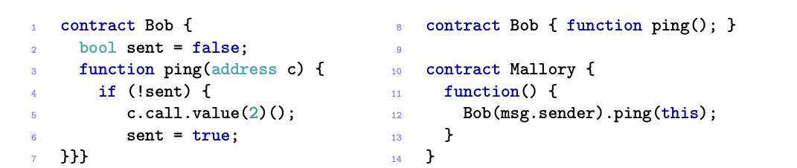
Reentrancy
when a non-recursive function is invoked, it cannot be re-entered before its termination.
The function ping in Bob is meant to send exactly 2 ether to some address c, using a call with empty signature and no gas limits. Now, assume that ping has been invoked with Mallory’s address. The call has the side effect of invoking Mallory’s fallback, which in turn invokes again ping. Since variable sent has not already been set to true, Bob sends again 2wei to Mallory, and invokes again her fallback, thus starting a loop. This loop ends when the execution eventually goes out-of-gas, or when the stack limit is reached

Slide 8
Keeping Secrets
Fields in contracts can be public, i.e. directly readable by everyone,
Fields in contract can be private, i.e. not directly readable by other users/contracts.
Does declaring fields as private guarantee its secrecy?

Slide 9
Immutable Bugs
Once a contract is published on the blockchain, it can no longer be altered.
The drawback is that if a contract contains a bug, there is no direct way to patch it.
Programmers have to anticipate ways to alter or terminate a contract in its implementation

Slide 10
Ether lost in transfer
To send an ether one has to specify recipients address
Recipients address takes a form of 160 bits
What will happen if an address is orphan?
Note: There is no way to detect whether an address is orphan
Lost ether cannot be recovered, programmers have to manually ensure the correctness of the recipient addresses.

Slide 11
Stack Size Limit
Each time a contract invokes another contract the call stack associated with the transaction grows by one frame.
The call stack is bounded to 1024 frames: when this limit is reached, a further invocation throws an exception.
Attackers can take advantage of it if exceptions are not properly handled.

Slide 12
Unpredictable State
The state of a contract is determined by the value of its fields and balance
when a user sends a transaction to the network in order to invoke some contract, he cannot be sure that the transaction will be run in the same state the contract was at the time of sending that transaction.
This may happen because, in the meanwhile, other transactions have changed the contract state. Even if the user was fast enough to be the first to send a transaction, it is not guaranteed that such transaction will be the first to be run. Indeed, when miners group transactions into blocks, they are not required to preserve any order; they could also choose not to include some transactions.
In some cases, not knowing the state where a transaction will be run could give rise to vulnerabilities.

Slide 13
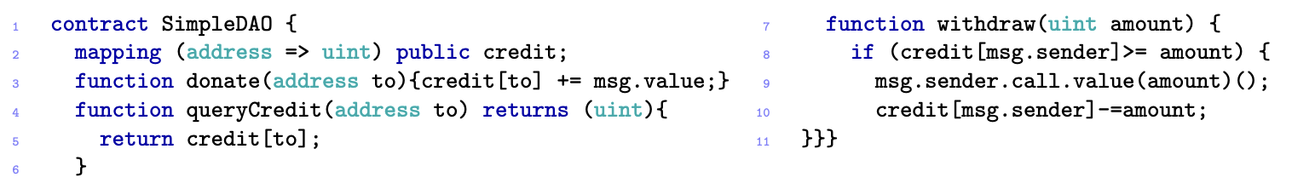
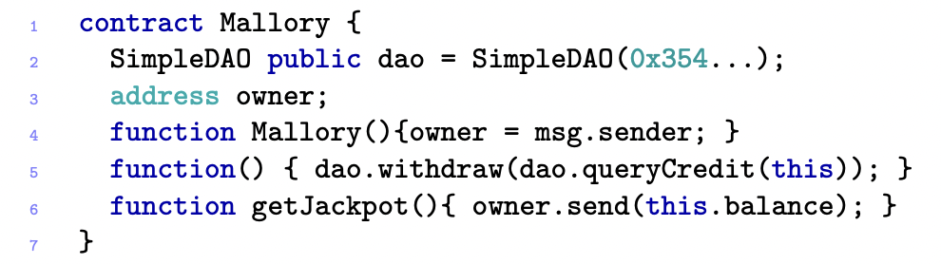
The DAO Attack
Simplified version of the DAO contract
Attack Contract

Slide 14
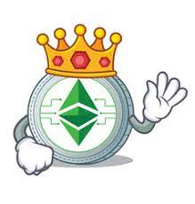
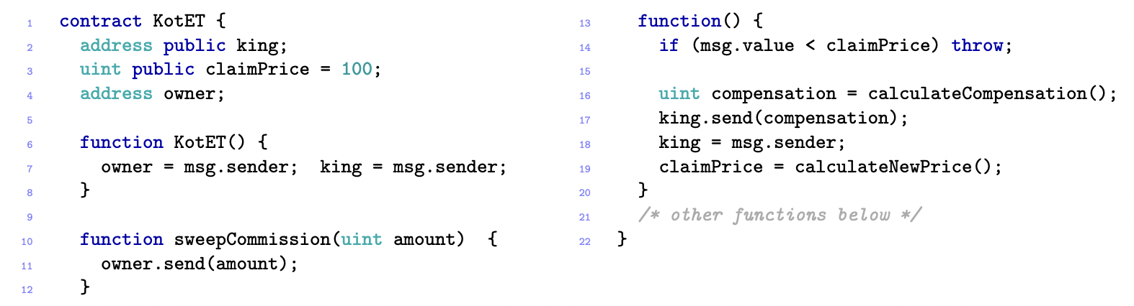
King of the Ether Throne
Exploits Gasless send vulnerability
Owner of contract is the adversary
Simplified version of KotET [8]

Slide 15
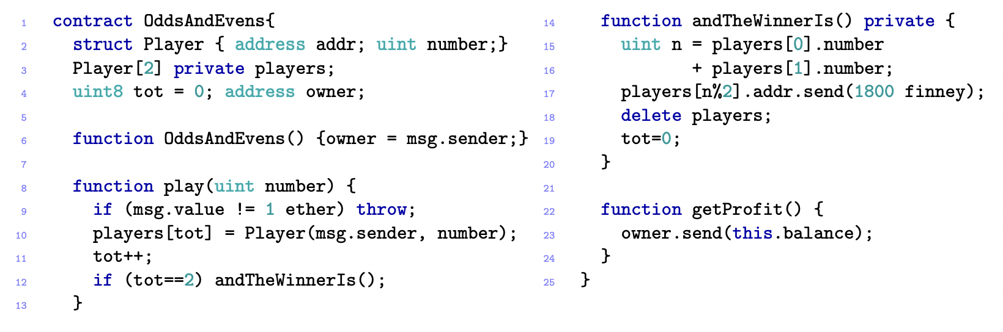
Multiplayer Games
Exploits the “keeping secrets” vulnerability

Slide 16
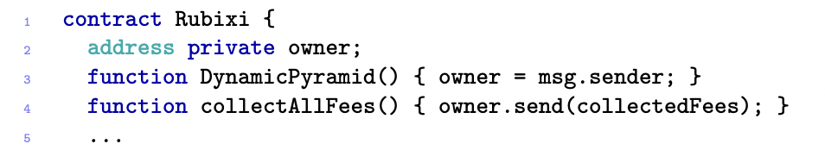
Rubixi
Expolits “Immutable bugs” Vulnerability.
Programmers forgot to change name of constructor due to which anyone could become the owner.

Slide 17
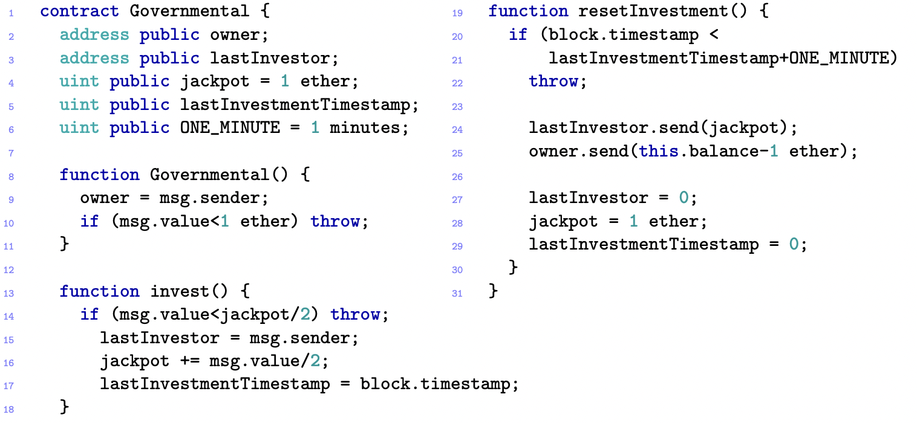
GovernMental
Simplified Governmental contract

Slide 18
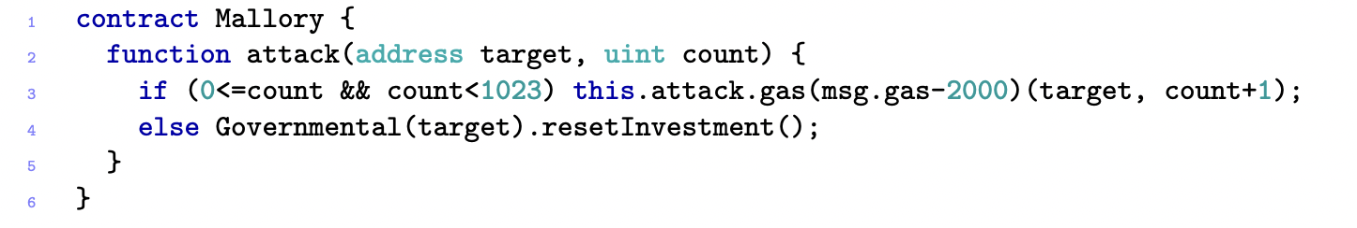
GovernMental
Exploits “exception disorder” and “Stack Size Limit” vulnerabilities.
Owner does not send ether to winner.

Slide 19
References
[1] https://eprint.iacr.org/2016/1007.pdf,Accessed 10/2022
[2] https://blog.vantagecircle.com/team-goals, Accessed 10/2022
[3]https://ethereum.org/en/developers/docs/smart-contract, Accessed 10/2022
[4]https://dashnews.org/ethereum-classic-suffers-possible-51-attack-latest-in-string-of-smaller-coin-attacks, Accessed 10/2022
[5]https://github.com/fischlerben/Smart-Contracts-With-Solidity, Accessed 10/2022
[6]https://www.istockphoto.com/illustrations/table-of-contents, Accessed 10/2022
[7]https://devops.com/top-10-common-software-vulnerabilities, Accessed 10/2022
[8]https://www.vectorstock.com/royalty-free-vector/king-ethereum-classic-character-cartoon-vector-19215289, Accessed 10/2022

Slide 20
Thank you
Questions?

